Slide 1

Factorising By Grouping

Slide 2
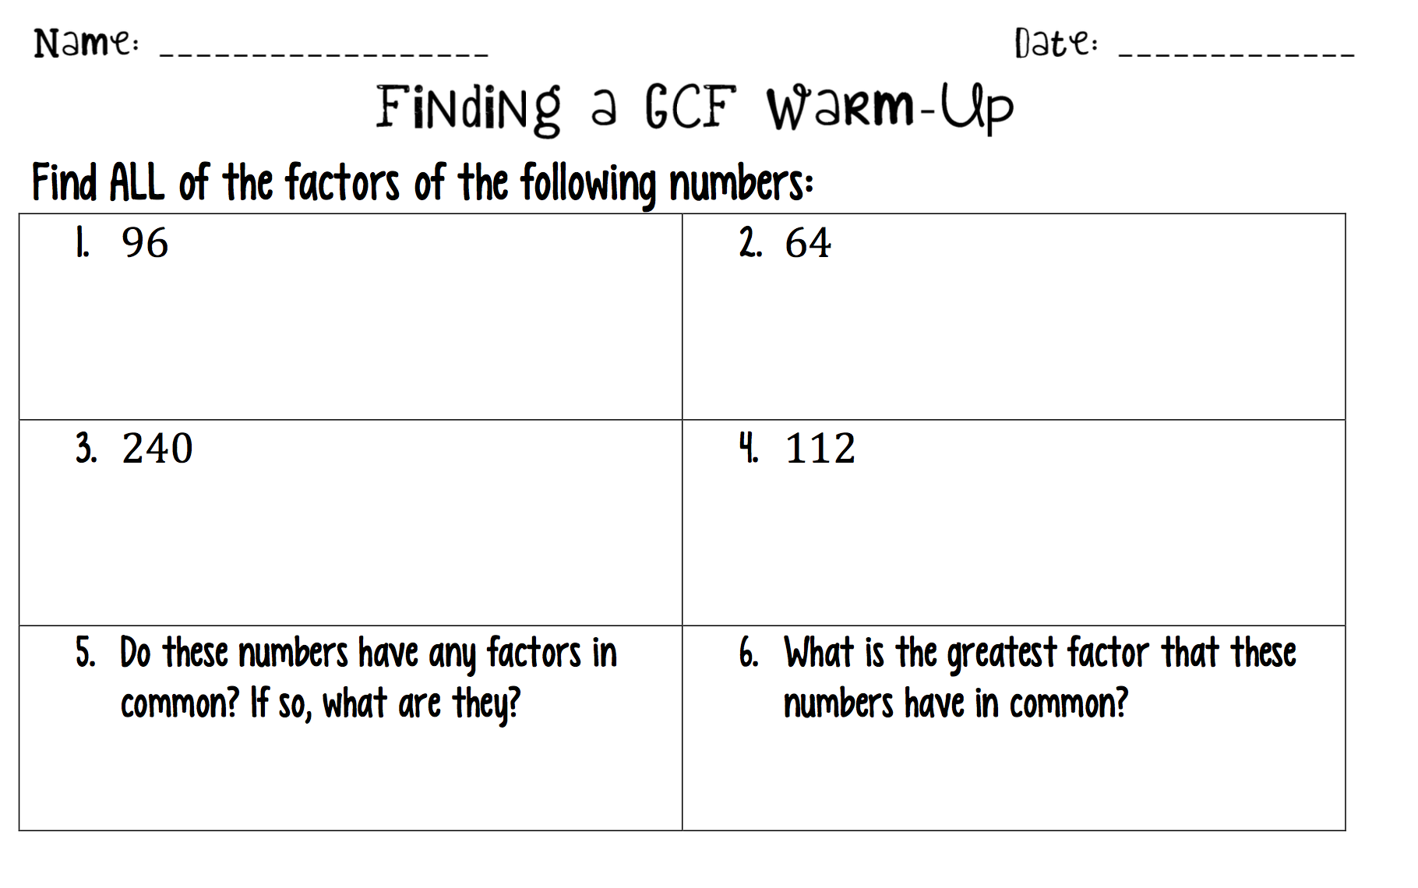
Warm up
Review Factorising

Slide 3
Direct Teaching
http://www.shmoop.com/polynomials/grouping.html

Slide 4
EQ: How do we factor a trinomial with a leading coefficient greater than 1?
Note Taking:
How would you factor the following trinomial?
2x² + 5x + 2
Since we can't factor out a GCF to get a leading coefficient of 1, we would have to use a method called "Grouping".

Slide 5
How do I Factor by Grouping?
Steps
Example
1) Find the product of a and c
2x² + 5x + 2
2) Rewrite the middle term as the sum of two terms
that add to the product
2x² + 4x + 1x + 2
2x² + 4x + 1x + 2
3) Once you have four terms, make two groups
2x (x + 2) + 1 (x + 2)
4) Pull to the front the Common Factor ie. Factorise
(x + 2) + 2x + 1
5) Write the GCF's together as one binomial
(x + 2)
6) Write the other common factor as one binomial
(x + 2) (2x + 1)
7) Check your answer by expanding it out again using FOIL.

Slide 6
Let's try it again...
3x² + 10x + 8
3x² + 6x + 4x + 8
3x(x + 2) 4 (x + 2)
(x + 2) (3x + 4)

Slide 7
You Try
2x² + 22x + 20 4x² -11x + 6

Slide 8
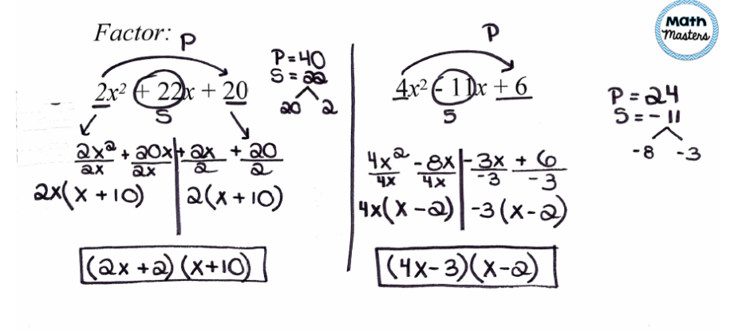
Solutions

Slide 9
Mini-Whiteboard Activity
Complete each problem with your partner. Show all working ie. every step
2) Agree on an answer.
3) Write the answer on your whiteboard.
4) Hold up your whiteboard when I instruct to do so.

Slide 10
Additional Activity
Factoring By Grouping Connect 4 Partner Game.

Slide 11
Closure
Snowstorm
Students write down what they learned on a piece of scratch paper and screw it up. Given a signal, they throw their paper /snowballs in the air. Then each Student picks up a nearby response and reads it aloud.

